Slide 1

DA332 :
Data Visualization
Topic : Education - A Brief Analysis Of Enrollment Statistics
Presented By :
Palthiya Laanith Chouhan
210150014

Slide 2


Motivation :
This project is fueled by the drive to analyze the complex patterns of student enrollment through insightful data visualization. By delving into class-wise and district-wise enrollment data spanning multiple years, it aims to uncover meaningful insights that inform educational policy and practice.

Slide 3



Datasets
A set of 8 CSV (Comma Separated Value) files that show district wise and state wise, class and gender-wise enrolments from the year 2012-2020
The dataset is found on data.gov.in.
A short demographic overview :
24 columns of names class_<class_no>_<gender>
Each of those columns spanning over roughly 780 districts.

Slide 4
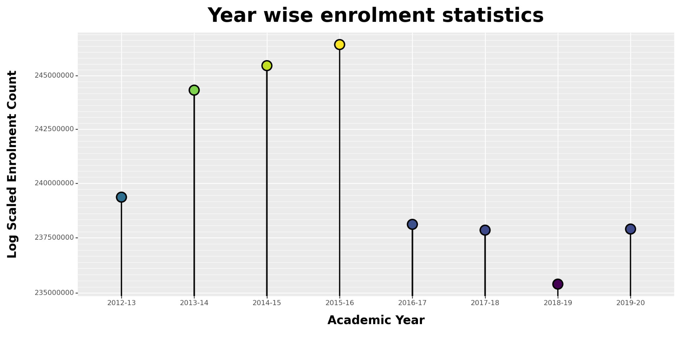

Year Wise Enrolment Statistics
Utilizing a categorical chart type is ideal for analyzing categorical data, leading us to employ custom made Lollipop chart using Plotnine Library.

Slide 5

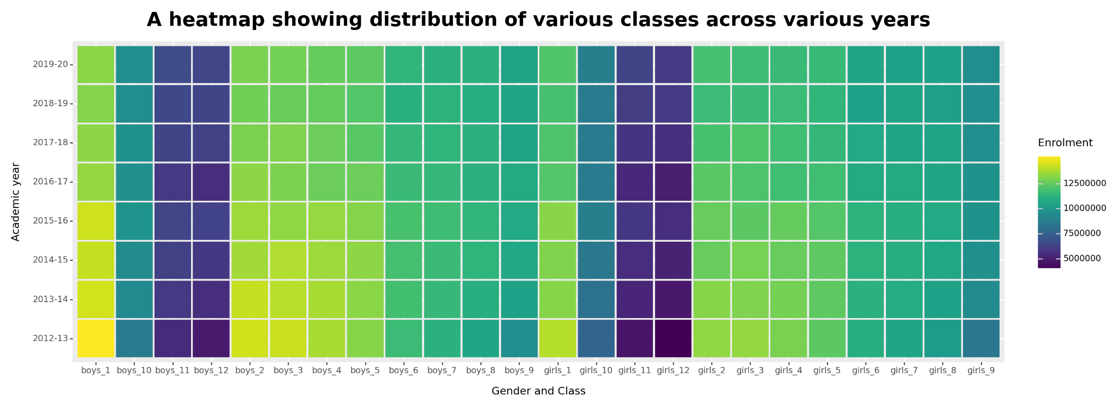
Observing the Distribution of Data in greater detail

Slide 6
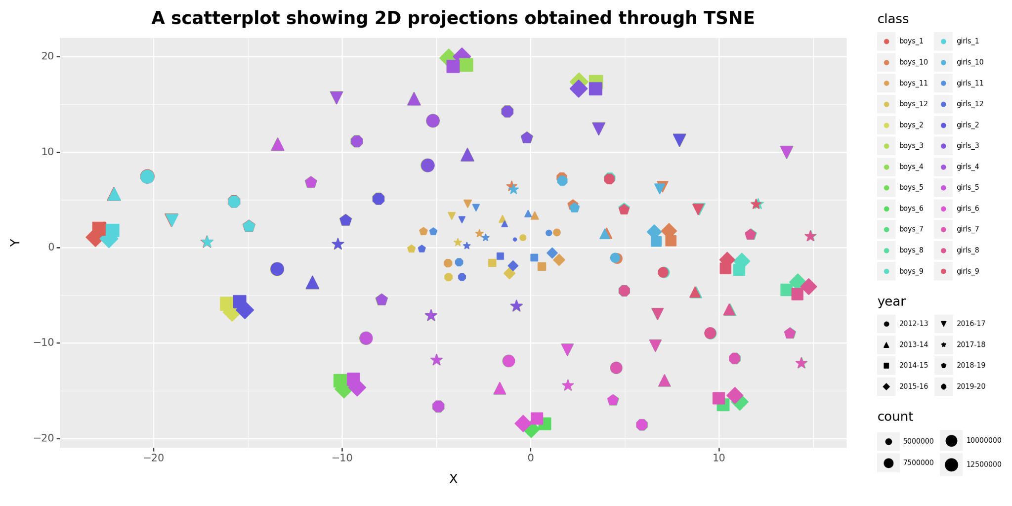
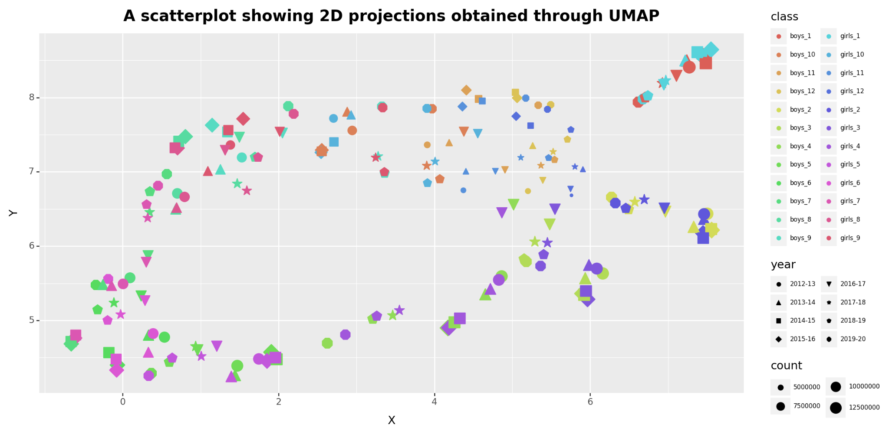
2D Projections
Points of same shape and adjacent colors in legend are either overlapping or in proximity to each other.They are also of same size.
This indicates that the enrolment distribution of boys and girls across the states and districts is quite similar, and this backs up the previous plot shown by the heatmap.

Slide 7
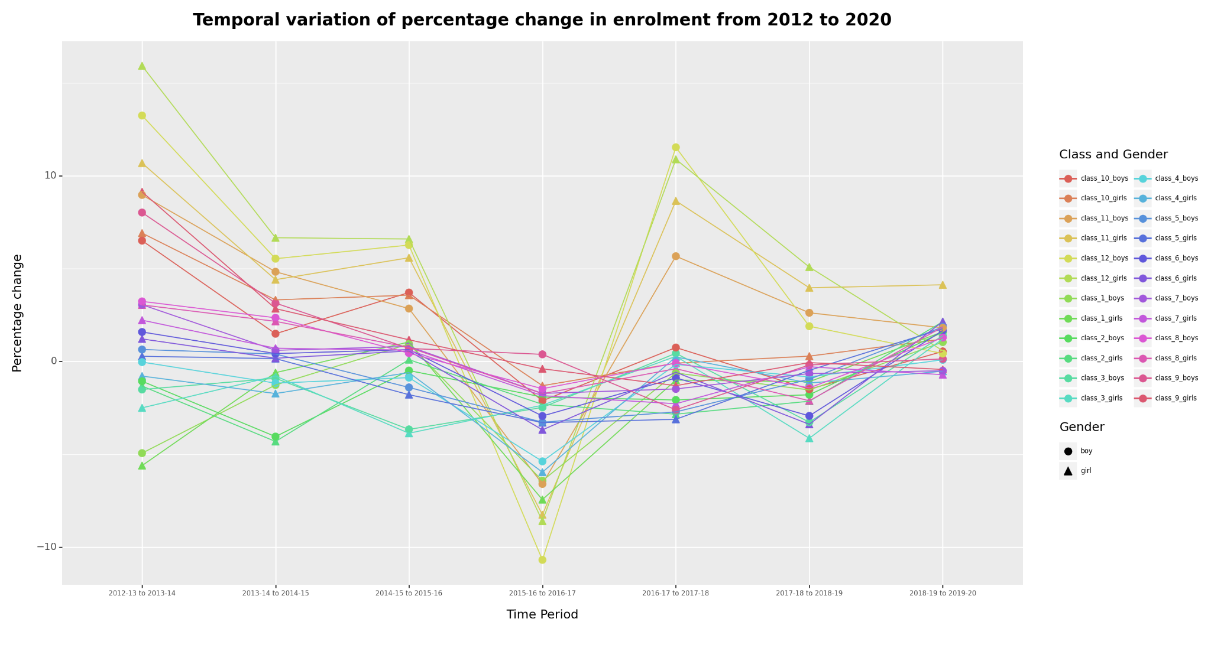

A Temporal Anomaly
Observing an intriguing anomaly in the plot, there's a noticeable decline in enrollment rates for several classes, including class-12 boys, class-12 girls, and class-11 girls. Further investigation revealed a correlation with the highest average annual dropout rate for secondary schools in India, which peaked at 17.06 percent in 2016. While this sheds light on the enrollment decline that year, the underlying causes for the surge in dropout rates remain a mystery.

Slide 8
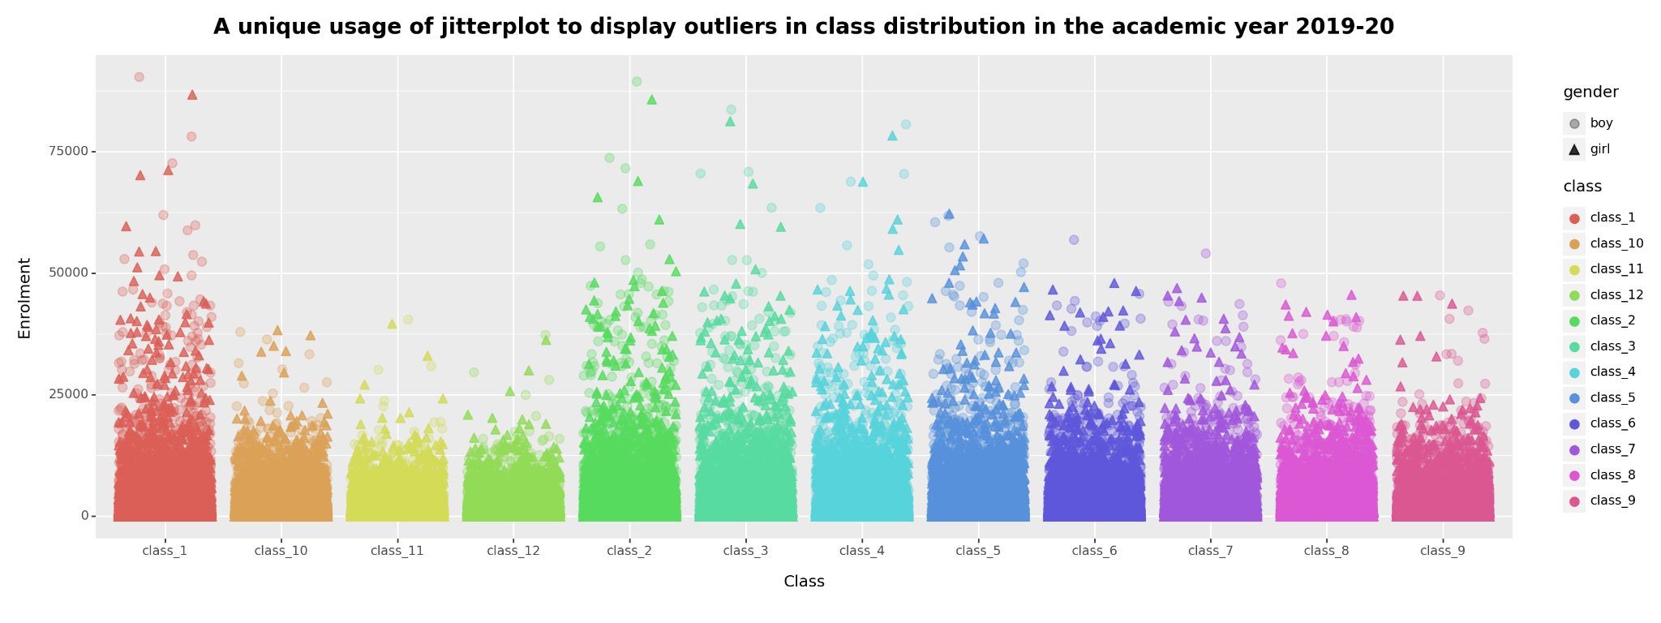

A look into the Outliers
Analyzing district-wise data distribution poses challenges, especially with many districts having zero class enrollment, significantly impacting the dataset. Traditional methods like box plots and violin plots exhibit bias towards these districts, resulting in skewed distributions. To mitigate this bias, a jitter plot is utilized, assigning distinct shapes and opacity to distinguish between boys and girls.
Insights :
Insights reveal that maximum enrollment in classes 11th and 12th does not surpass approximately 37,500, with enrollment declining as students progress to higher grades.

Slide 9
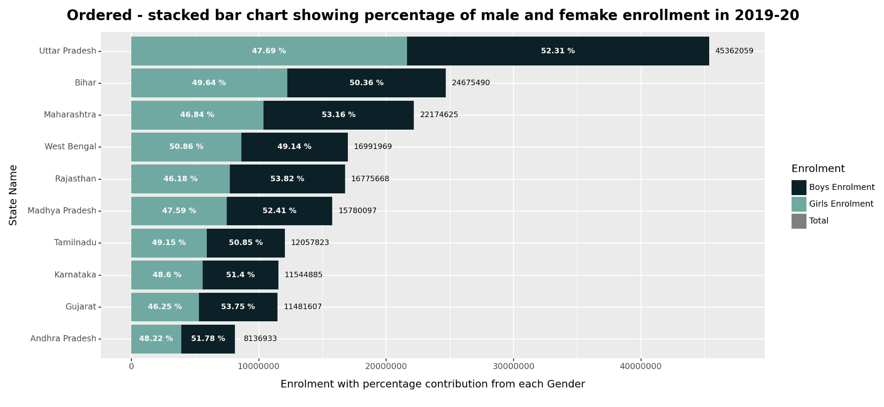

Percentage contribution of Each Gender
Insights :
The ordered stacked bar chart for 2019-20 enrollment across top 10 Indian states reveals a consistent gender disparity, with male enrollment consistently higher than female enrollment. Uttar Pradesh exhibits the highest gender gap at 52.31% male enrollment, while West Bengal shows the lowest gap at 50.86% female enrollment. Overall, Uttar Pradesh records the highest total enrollment at 45,362,059, while Andhra Pradesh reports the lowest at 8,136,933.

Slide 10
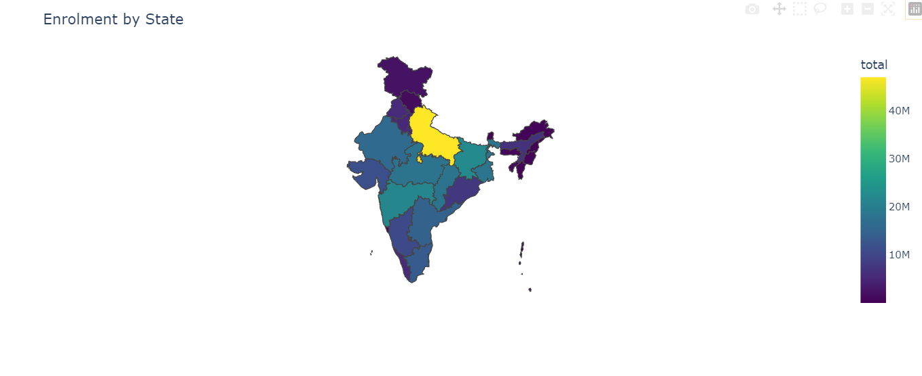
State wise enrolment distribution
Insights :
The enrollment patterns broadly align with the population distribution in India, where more populous states like Uttar Pradesh, Bihar, and West Bengal (darker shades) have higher enrollment numbers.

Slide 11

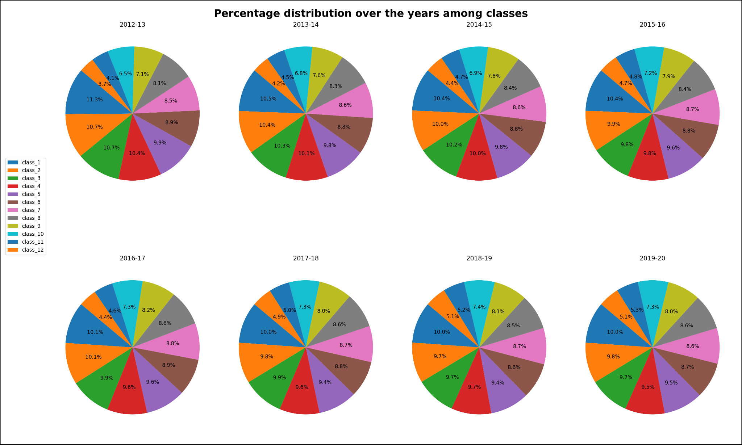
A view of Data through Pie Charts
The pie charts depict percentage enrollment distribution across different classes in India from 2012-13 to 2019-20.
Class 1 consistently shows the highest enrollment percentage, indicating a focus on primary education.
Enrollment percentages gradually decline as students progress to higher grades, with classes 6 to 12 exhibiting lower percentages overall.
Class 12 consistently records one of the lowest percentages, suggesting significant dropout rates at the higher secondary level.
Despite minor fluctuations, distribution patterns remain relatively stable, highlighting persistent challenges in enrollment and dropout rates that require targeted interventions for improved educational outcomes.

Slide 12

Thank you for attending!

